Slide 1
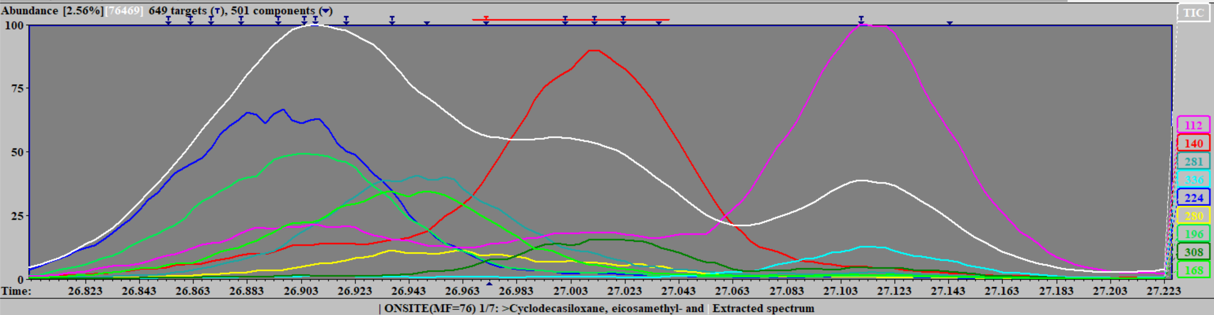
AMDIS DECONVOLUTION Cataglyphis iberica queen cuticular hydrocarbon sample CI23_Q_120828_01.CDF
(AMDIS detected peaks are indicated with arrows at the top, manual annotations indicated below)
cf. Van Oystaeyen et al. Science 2014
9-Methylnonacosane
140+308
RT 27.01
7-Methylnonacosane
112+336
RT 27.11
15-Methylnonacosane
224+225
RT 26.84
13-Methylnonacosane
196+252
RT 26.91
11-Methylnonacosane
168+280
RT 26.95
Cyclodecasiloxane, eicosamethyl
73+147+221+281+355++429+503
RT 26.95

